Slide 1

Online Simulator
By Catey Meador

Slide 2
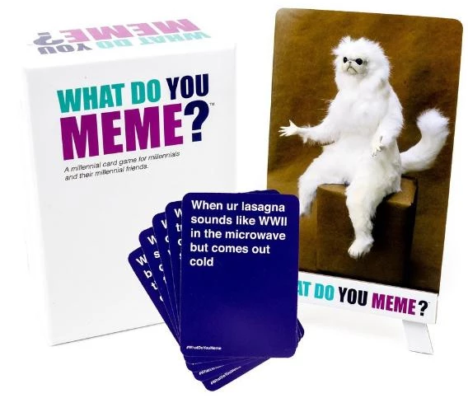
Project Recap
Originally a card game
Meme prompt cards
Text response cards
Goal: create a similar online card game

Slide 3
Testing
Function
Users should be able to:
Create a game
Join a game using a code
Select a response card
Eventually be able to view each players response in the round
Select their favorite pairing (as judge or voter)
The system should:
Assign a code to a new game when it is created
Deal each player a hand of response cards
Deal a prompt card
Add players to their game corresponding to the code they enter
End the game when the win condition is met
Administrator should be able to:
Add pre-set decks of response cards
Add pre-set decks of prompt cards
Results
Users
Confused by non-functional buttons
System
Unsure when to press buttons
Administrator
Just me
No UI for adding decks

Slide 4
Differences from Original Concept
No photos
No lobbies
No accounts
No decks
Local multiplayer
Not dynamic

Slide 5
Demonstration

